Slide 1
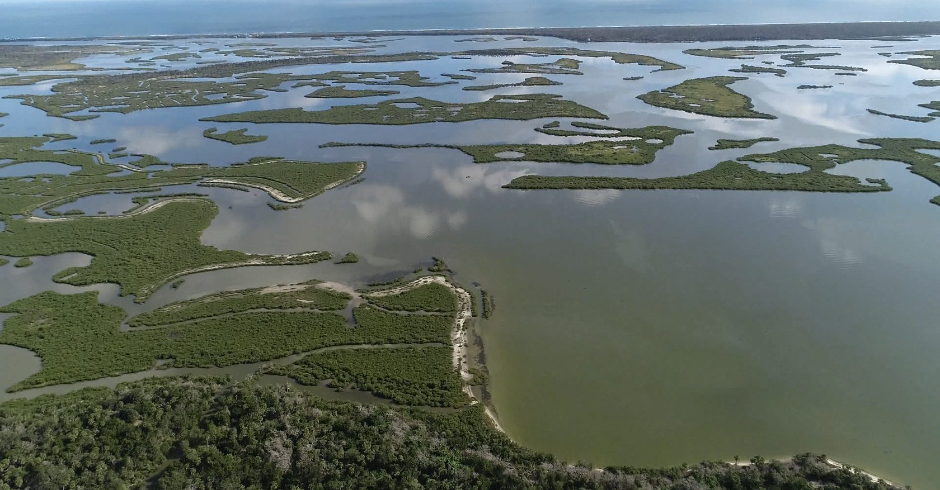
UAV/Drone GIS processing
Dr. Bo Yang
Bo.Yang@ucf.edu
Department of Sociology, University of Central Florida;
Citizen Science GIS, University of Central Florida

Slide 2
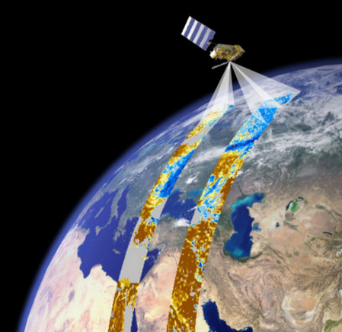
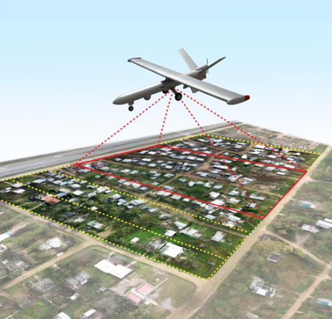
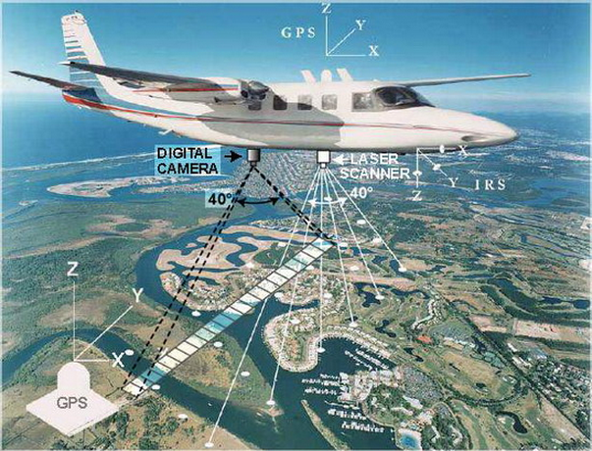
Types of remote sensing data
Introduction
Satellite remote sensing
Aerial remote sensing
UAV remote sensing
Notes:
On the other hand, remote sensing data can obtain an image,
Meanwhile there is a trade-off between spatial and temporal resolution.
For example, Landsat have 30m spatial resolution but 16 day revisiting cycle,
MODIS have daily frequency. But the spatial resolution is relatively low.

Slide 3
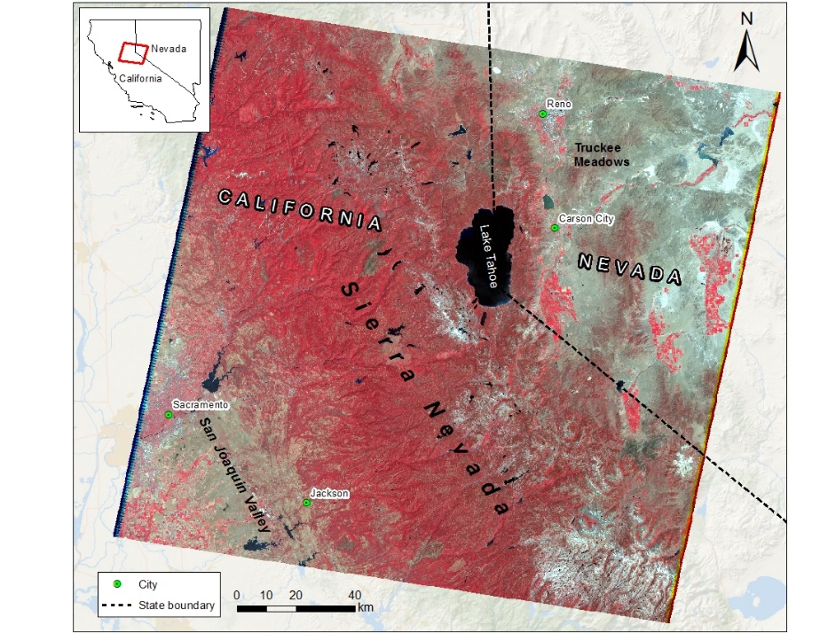
Satellite remote sensing
Introduction
Pros
Temporal revisiting cycle, historical data
Easier to obtain
Multi-spectral data
Cons
Moderate spatial resolution
Can’t obtain the target day
Cloud coverage
Landsat NIR false color composition multi-spectral imagery
Notes:
On the other hand, remote sensing data can obtain an image,
Meanwhile there is a trade-off between spatial and temporal resolution.
For example, Landsat have 30m spatial resolution but 16 day revisiting cycle,
MODIS have daily frequency. But the spatial resolution is relatively low.

Slide 4
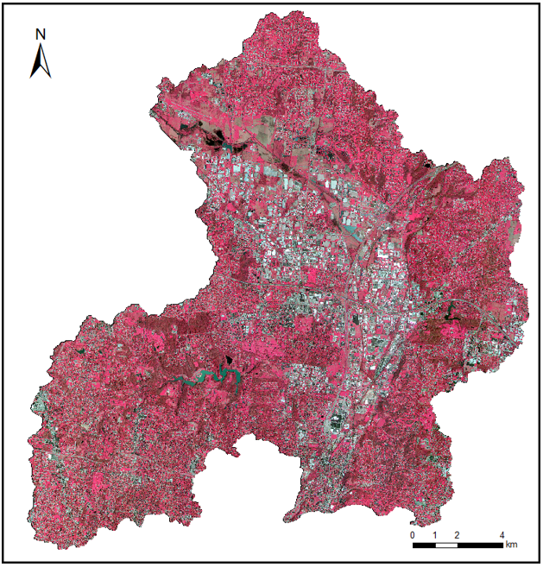
Aerial remote sensing
Introduction
Pros
High spatial resolution
Date can be control
Multi-spectral, LiDAR, Thermal sensor optional
Cons
Expensive
Need pilot and plane
Long repeating cycle
OSIP aerial imagery NIR false color combination at 1 m resolution
Notes:
On the other hand, remote sensing data can obtain an image,
Meanwhile there is a trade-off between spatial and temporal resolution.
For example, Landsat have 30m spatial resolution but 16 day revisiting cycle,
MODIS have daily frequency. But the spatial resolution is relatively low.

Slide 5
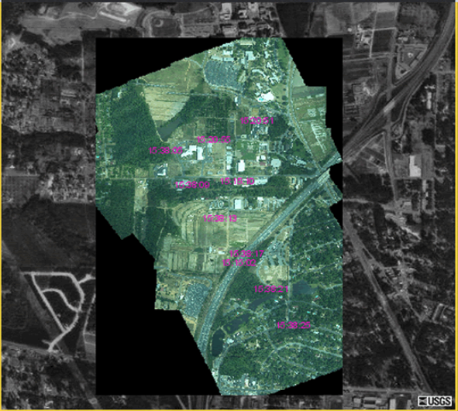
UAV remote sensing
Introduction
Pros
High spatial resolution
Real-time data acquiring
Cheap and convenient
Cons
Accuracy
Image stitching and processing
Data validation
USGS Drone imagery
Notes:
On the other hand, remote sensing data can obtain an image,
Meanwhile there is a trade-off between spatial and temporal resolution.
For example, Landsat have 30m spatial resolution but 16 day revisiting cycle,
MODIS have daily frequency. But the spatial resolution is relatively low.

Slide 6
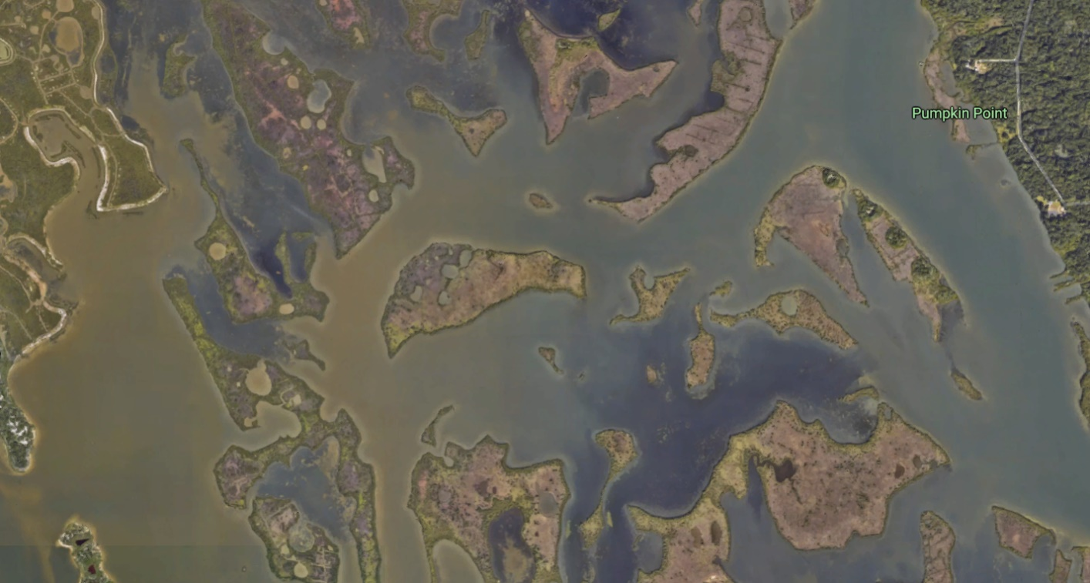

Drone vs. satellite mapping
Introduction
In addition to providing spectacular photos and videos for their aesthetic value, drone imagery can complement satellite imagery to improve scientific analysis and resource management.
Drones have the power to obtain real-time, high-resolution images, as well as footage features.
You can see how the drone image (right) is more clear and up-to-date than the satellite imagery (left).
Notes:
On the other hand, remote sensing data can obtain an image,
Meanwhile there is a trade-off between spatial and temporal resolution.
For example, Landsat have 30m spatial resolution but 16 day revisiting cycle,
MODIS have daily frequency. But the spatial resolution is relatively low.

Slide 7
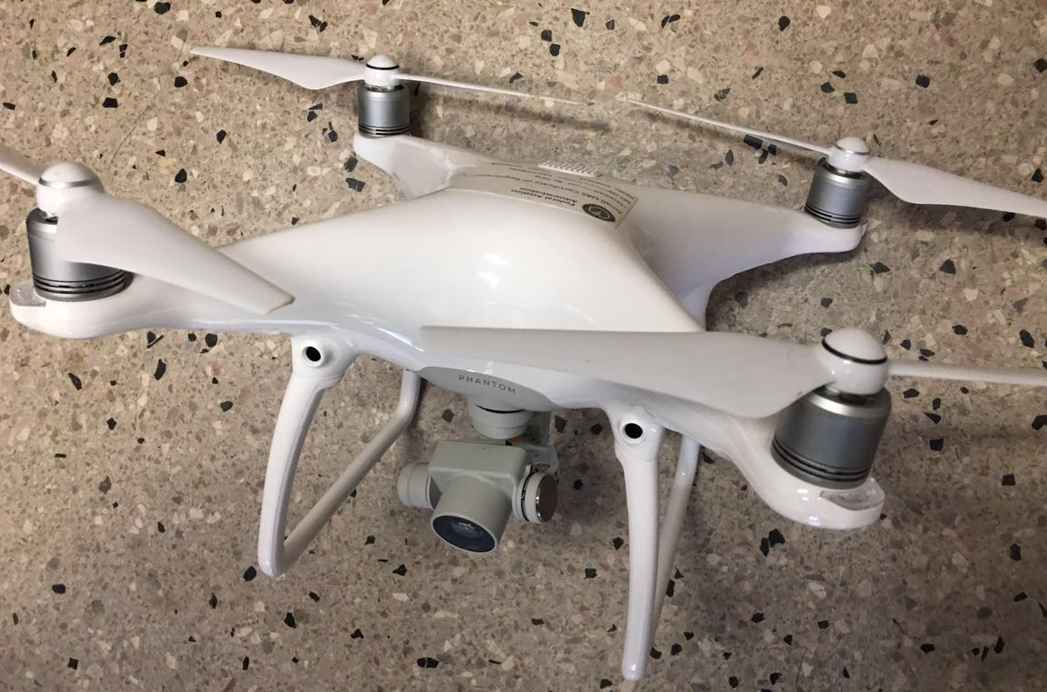
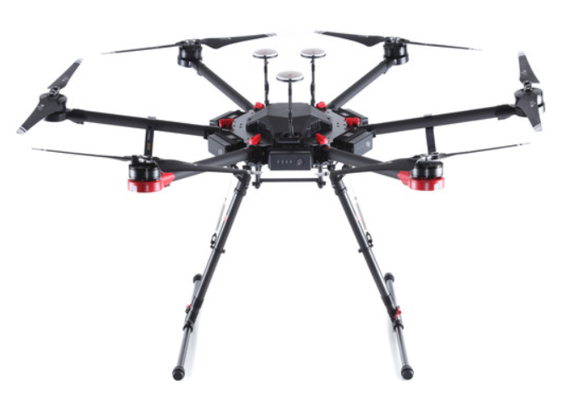
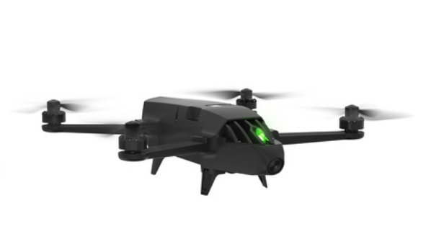
UAVs
Materials
DJI phantom 4 Pro
Parrot Bluegrass
DJI Matrice 600 Pro
Budget: $3000
Fly time: 28 min
Payload: 600g
Budget: $2000
Fly time: 26 min
Payload: 500g
Budget: $8000
Fly time: 42 min
Payload: 1000g

Slide 8
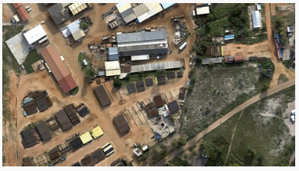
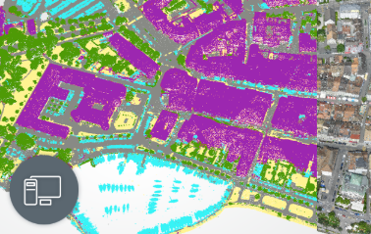
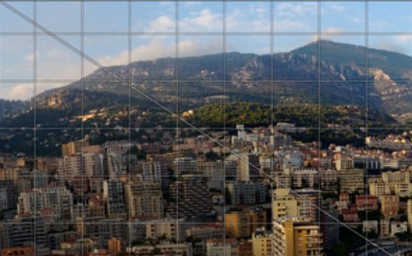
Drone image processing tools
Materials
Esri Drone2Map
Orthomosaic Imagery
Ground Control Points (GCPs)
Elevation products
3D Imagery Products
Pix4D Mapper
Purely from images
Machine-learning algorithm
Point cloud classification
Camera self-calibration
Agisoft PhotoScan
Georeferenced orthomosaic export
Photogrammetric triangulation
Dense point cloud:
editing and classification

Slide 9
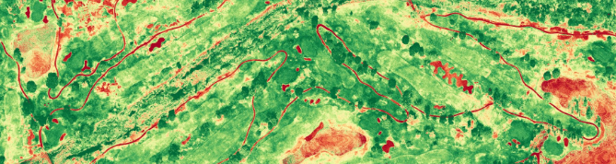
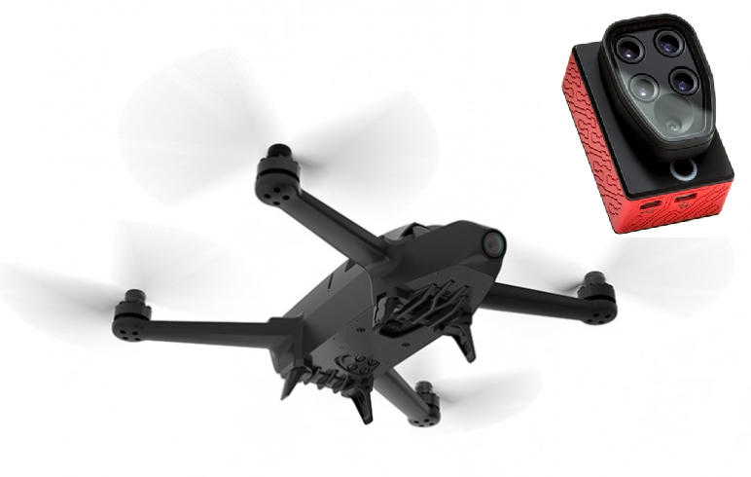
Sensors
Materials
Bluegrass multi-spectral camera
NIR, Red edge, Red, Green, Blue
The filters capture 5 channels of light information
RGN Filter (NIR+ Red+ Green)

Slide 10
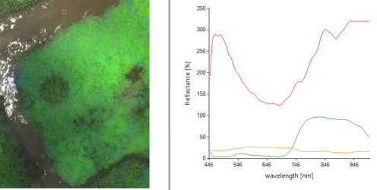
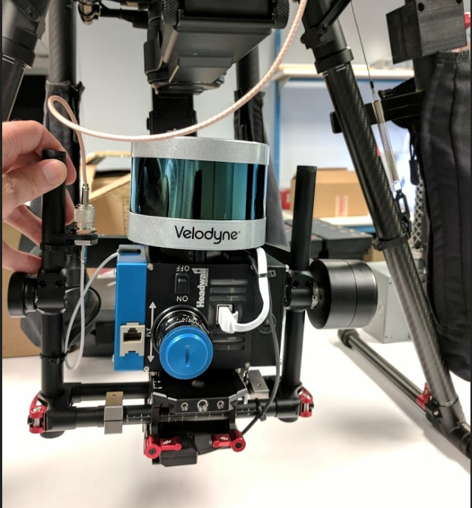
Sensors
Materials
Headwall Hyperspec VNIR Turnkey Package
Hyperspectral - 270 spectral bands
Ortho-rectification and RGB mosaic stitching
Standard GPS included, SpectralView spectral
Classification and data analysis

Slide 11
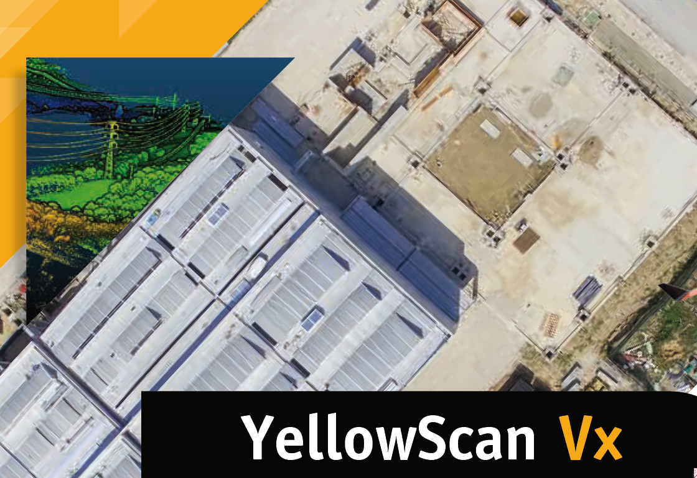
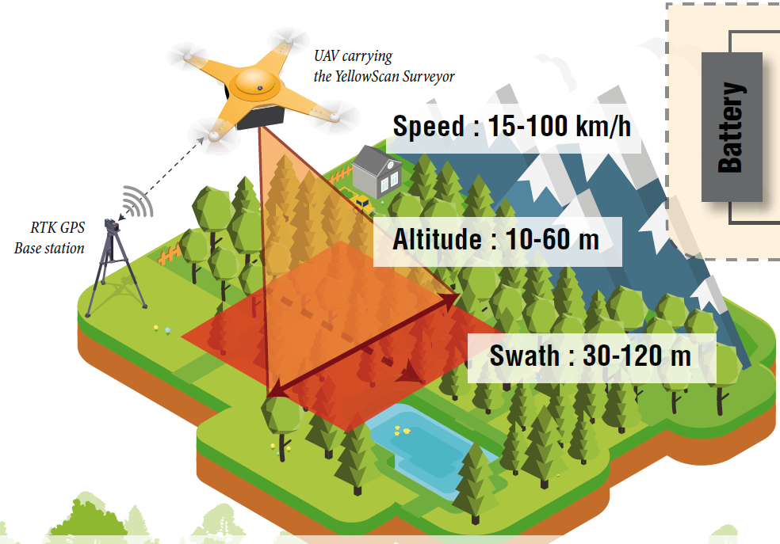
Sensors
Materials
YellowScan Mapper II UAV LiDAR sensor
UAV LiDAR scanner
High resolution DEM/DSM
Precision: 4 cm
Accuracy: 5 cm

Slide 12
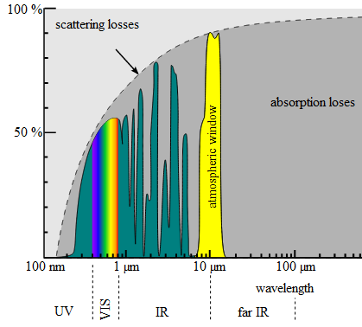
Advance of multi-spectral drone mapping
Materials
Vegetations are more responsive to the NIR band
Obtain a spectral signature from multi-spectral mapping
Better classification, canopy detection

Slide 13
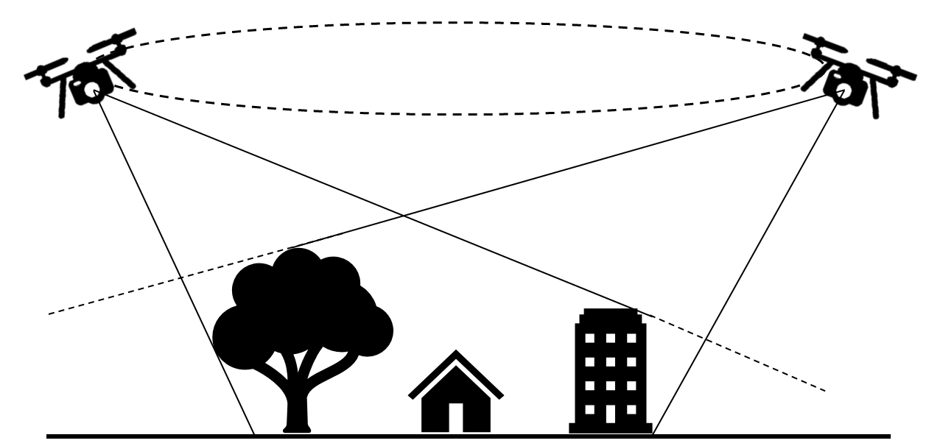
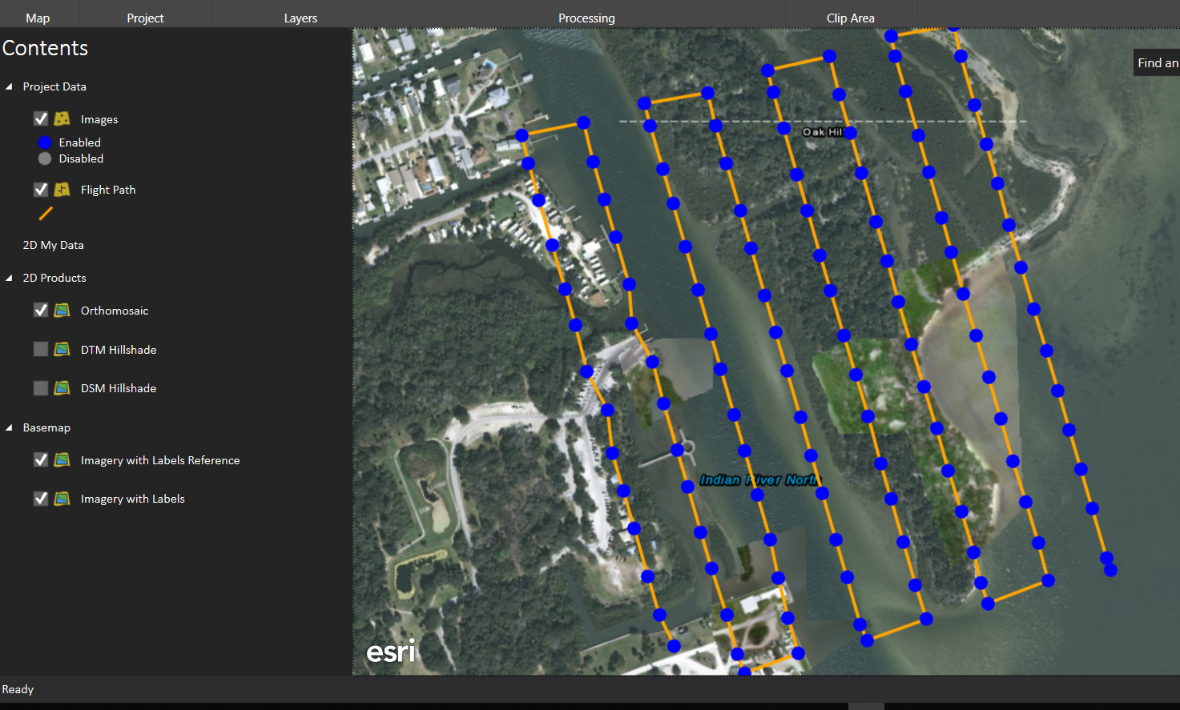
UAV high resolution data
Applications
Flying plan
GCPs and fly path
Notes:
On the other hand, remote sensing data can obtain an image,
Meanwhile there is a trade-off between spatial and temporal resolution.
For example, Landsat have 30m spatial resolution but 16 day revisiting cycle,
MODIS have daily frequency. But the spatial resolution is relatively low.

Slide 14
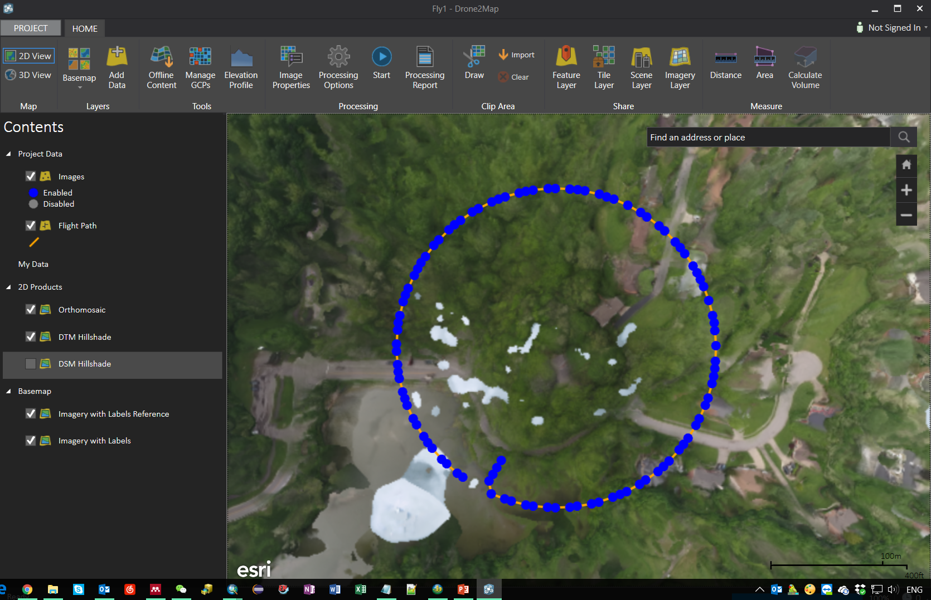
UAV high resolution data
Applications
UAV image stitching and processing - Orthomosaic image
Notes:
On the other hand, remote sensing data can obtain an image,
Meanwhile there is a trade-off between spatial and temporal resolution.
For example, Landsat have 30m spatial resolution but 16 day revisiting cycle,
MODIS have daily frequency. But the spatial resolution is relatively low.

Slide 15
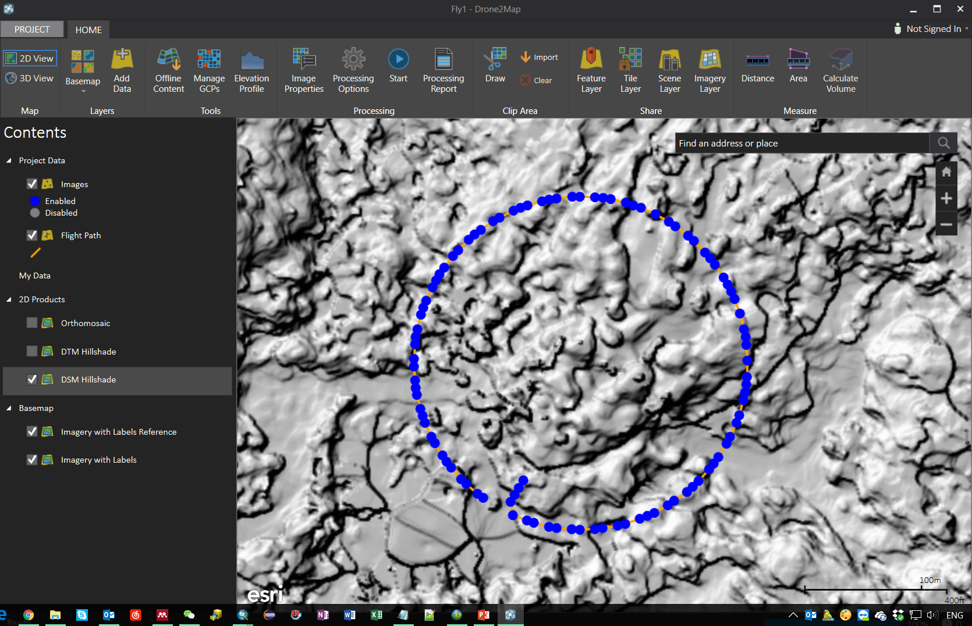
UAV high resolution data
Applications
UAV image stitching and processing - DSM hillshade
Notes:
On the other hand, remote sensing data can obtain an image,
Meanwhile there is a trade-off between spatial and temporal resolution.
For example, Landsat have 30m spatial resolution but 16 day revisiting cycle,
MODIS have daily frequency. But the spatial resolution is relatively low.

Slide 16
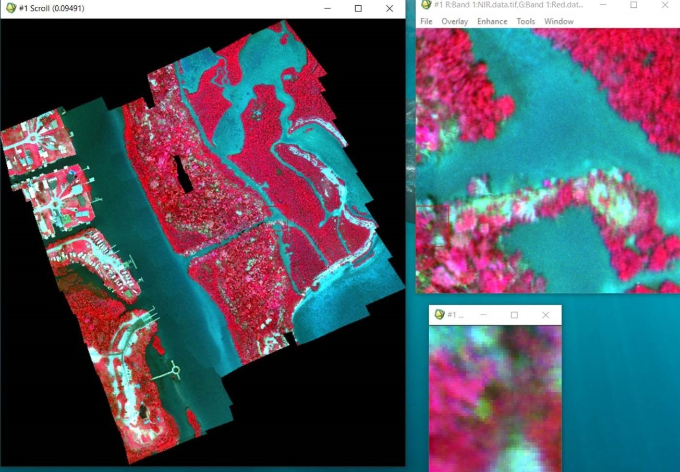
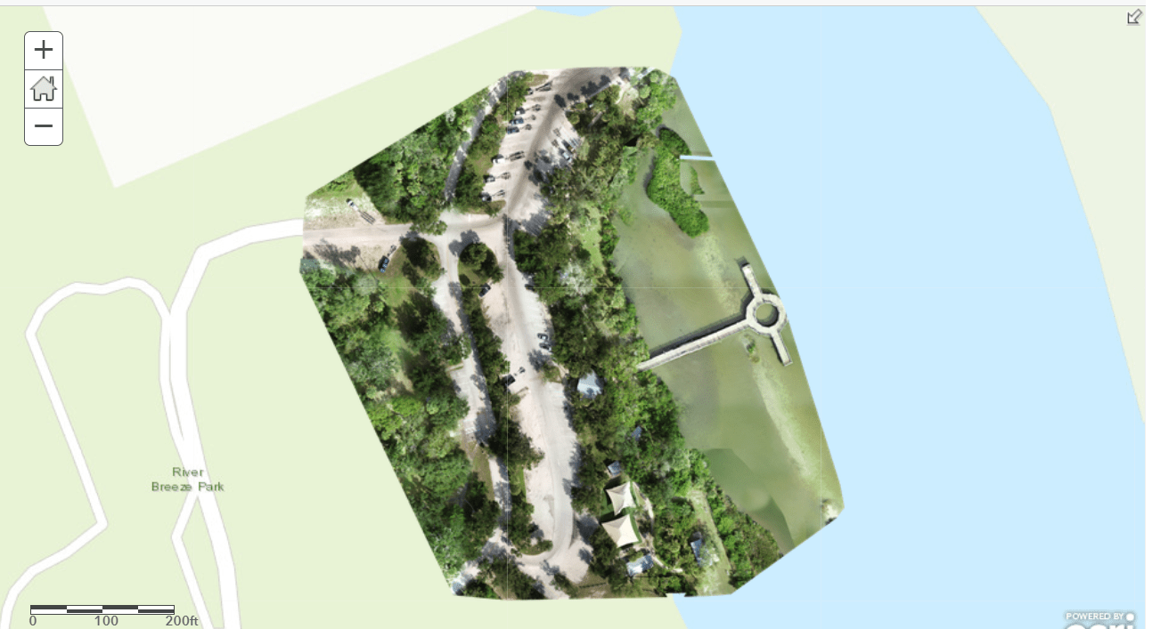
Multi-spectral and RGB data
Applications
Parrot multi-spectral
DJI RGB
Notes:
On the other hand, remote sensing data can obtain an image,
Meanwhile there is a trade-off between spatial and temporal resolution.
For example, Landsat have 30m spatial resolution but 16 day revisiting cycle,
MODIS have daily frequency. But the spatial resolution is relatively low.

Slide 17
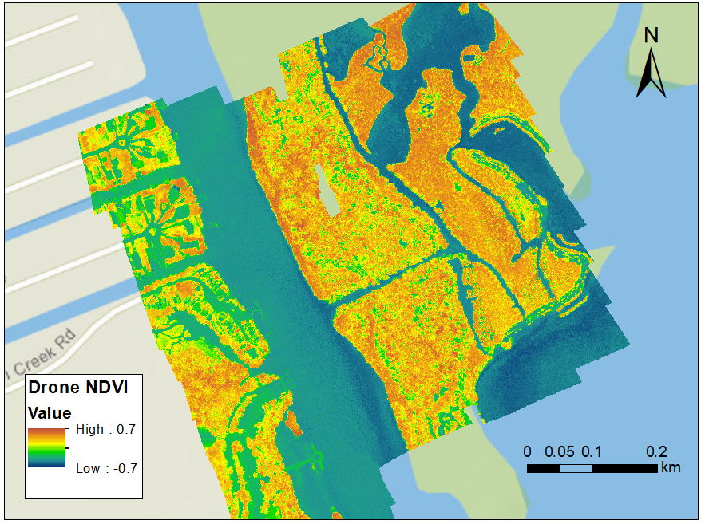
Normalized difference vegetation index (NDVI)
Applications
NDVI could be calculated from the drone mapping imagery.
NDVI is utilized to analyze whether the area contains live green vegetation or not.
water bodies (from −0.0175 to −0.328)
Built environment (−0.019 to 0.060)
bare soil (−0.001 to 0.166).
dense vegetation (0.500 to 0.575)
Notes:
On the other hand, remote sensing data can obtain an image,
Meanwhile there is a trade-off between spatial and temporal resolution.
For example, Landsat have 30m spatial resolution but 16 day revisiting cycle,
MODIS have daily frequency. But the spatial resolution is relatively low.

Slide 18
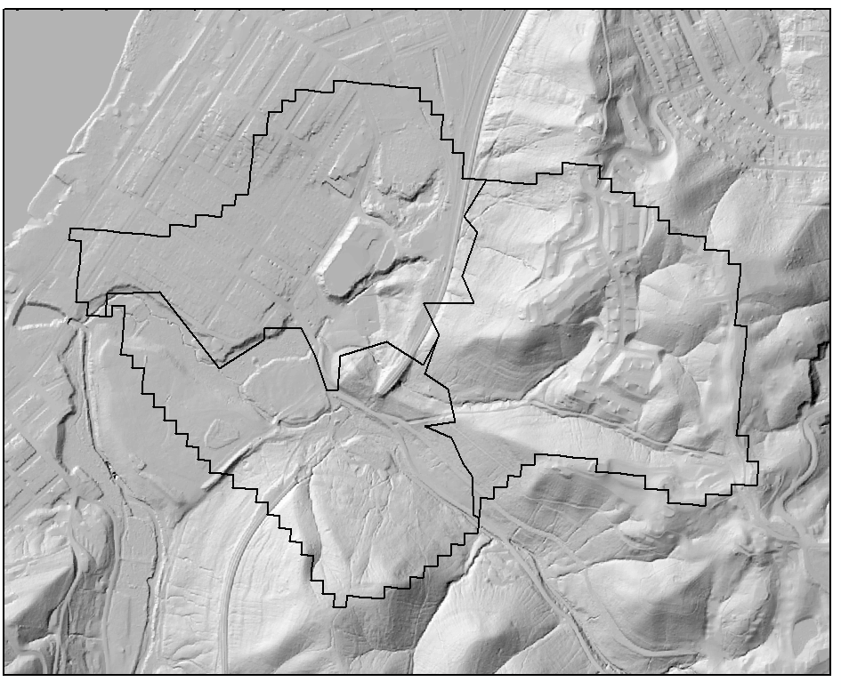
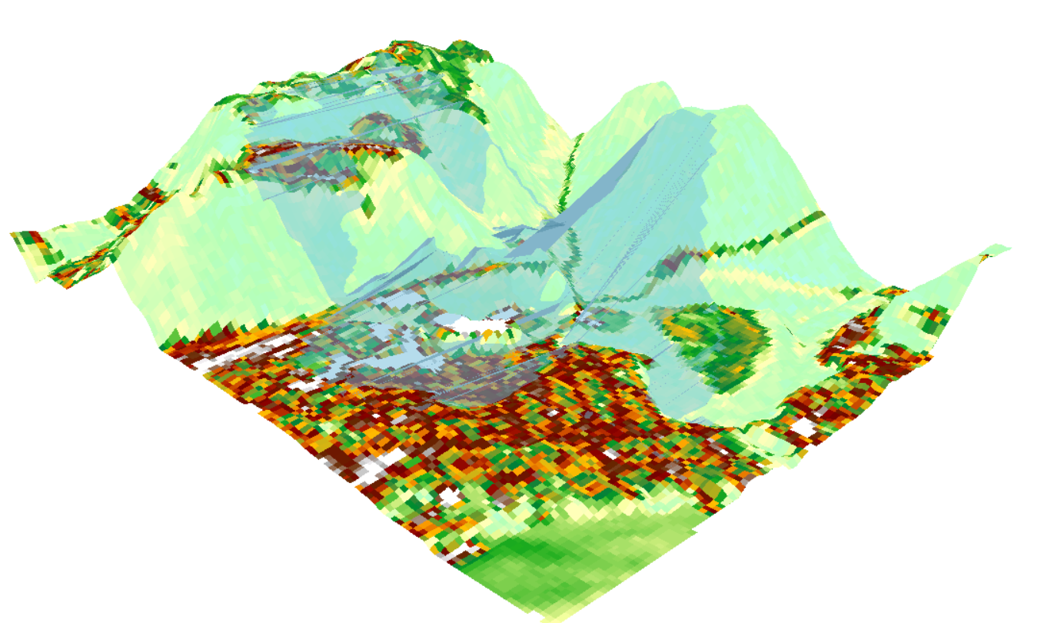
UAV high resolution data
UAV image stitching and processing
DEM hillshade (1 m)
3D View of DEM
Notes:
On the other hand, remote sensing data can obtain an image,
Meanwhile there is a trade-off between spatial and temporal resolution.
For example, Landsat have 30m spatial resolution but 16 day revisiting cycle,
MODIS have daily frequency. But the spatial resolution is relatively low.

Slide 19
The aims of field survey
1. To identify each feature of interest (e.g. each habitat type).
2. To locate representative areas of each feature in order to generate spectral signatures (spectra) from the imagery.
3. To generate adequate additional data to test the quality or accuracy of the image classification (i.e. habitat map).

Slide 20
Global Positioning Systems (GPS)
1. to measure the position of prominent features on an
image in situ which can be used to provide ground control
points for geometric correction
2. to assign positions to field data. These field data can
then be correlated with spectral information at the
same point on a geometrically corrected image.

Slide 21
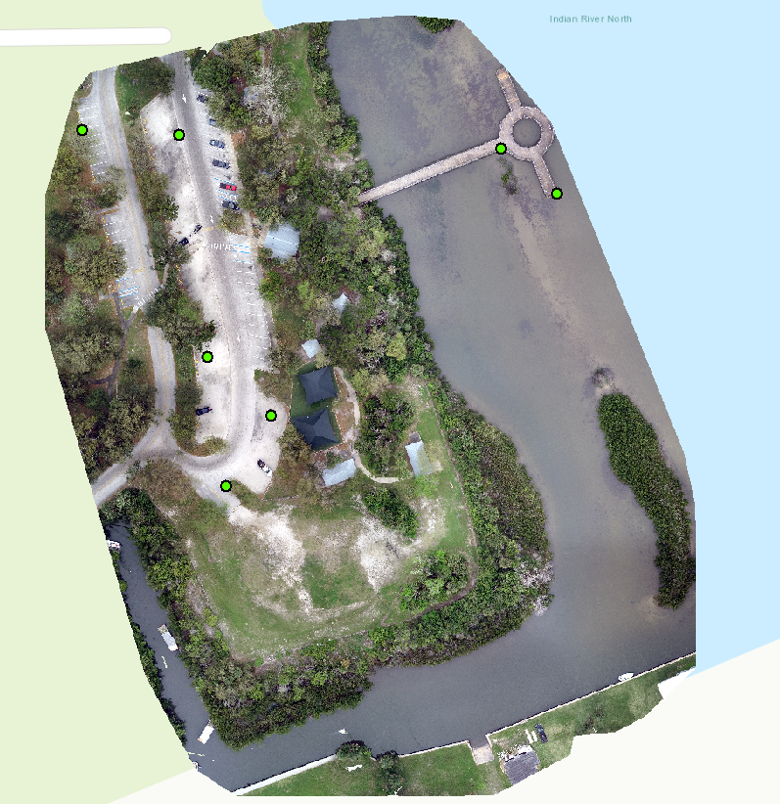
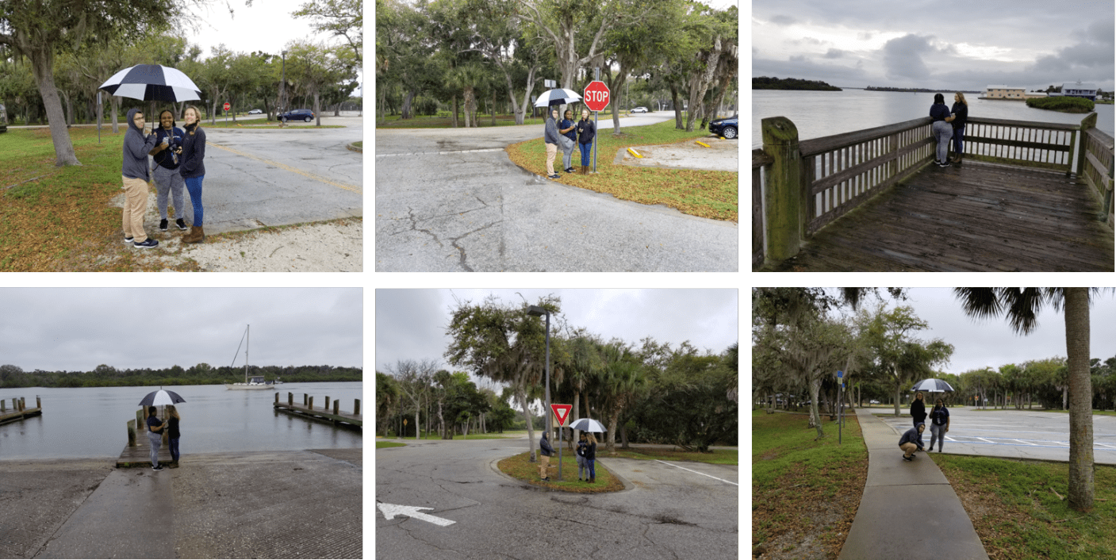
Ground Control Points (GCPs)
Applications
Use GCPs to calibrate the Drone imagery
Collected by Garmin R1 GNSS system
GPSs located in intersection/coner of roads
Notes:
On the other hand, remote sensing data can obtain an image,
Meanwhile there is a trade-off between spatial and temporal resolution.
For example, Landsat have 30m spatial resolution but 16 day revisiting cycle,
MODIS have daily frequency. But the spatial resolution is relatively low.

Slide 22
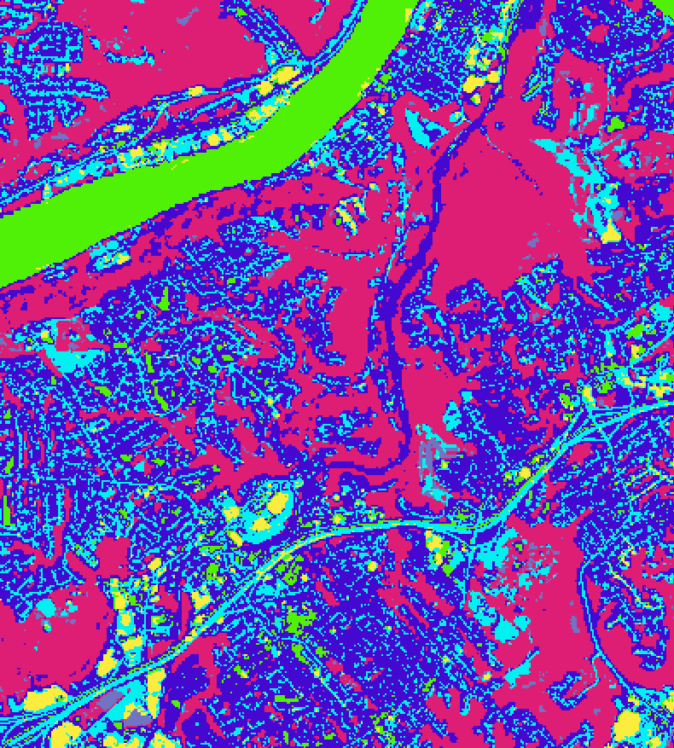
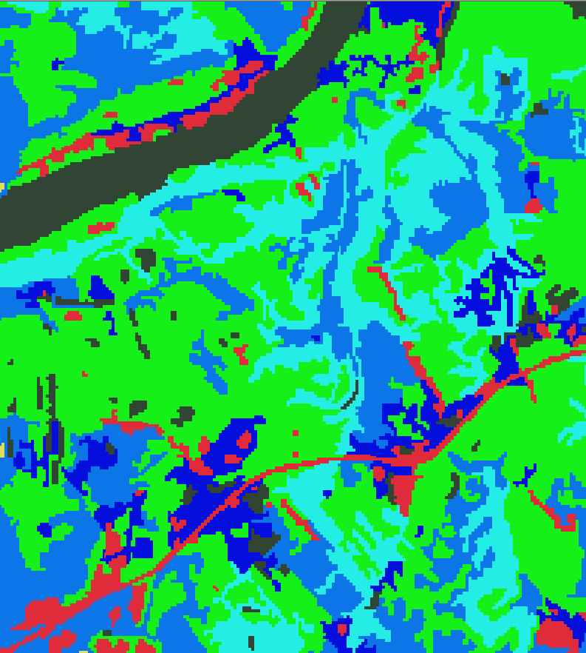
UAV imagery classification
Applications
Object oriented classification
Pixel based classification (ISODATA)
Object oriented classification
Notes:
On the other hand, remote sensing data can obtain an image,
Meanwhile there is a trade-off between spatial and temporal resolution.
For example, Landsat have 30m spatial resolution but 16 day revisiting cycle,
MODIS have daily frequency. But the spatial resolution is relatively low.

Slide 23
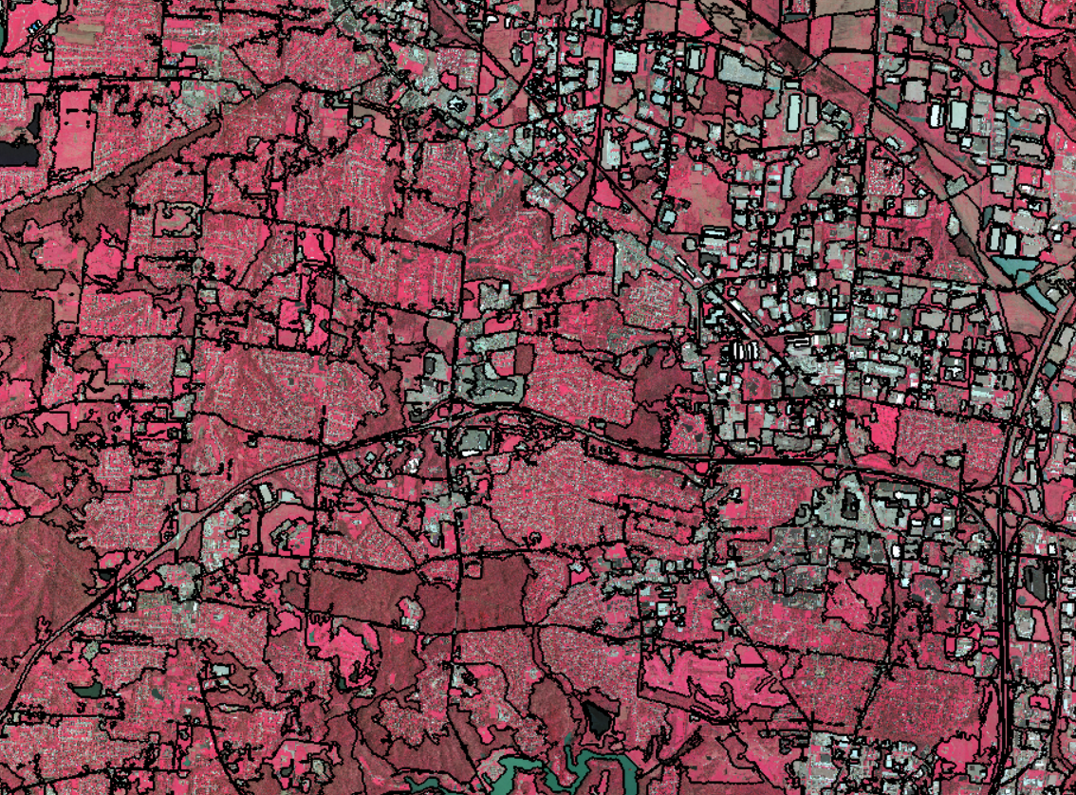
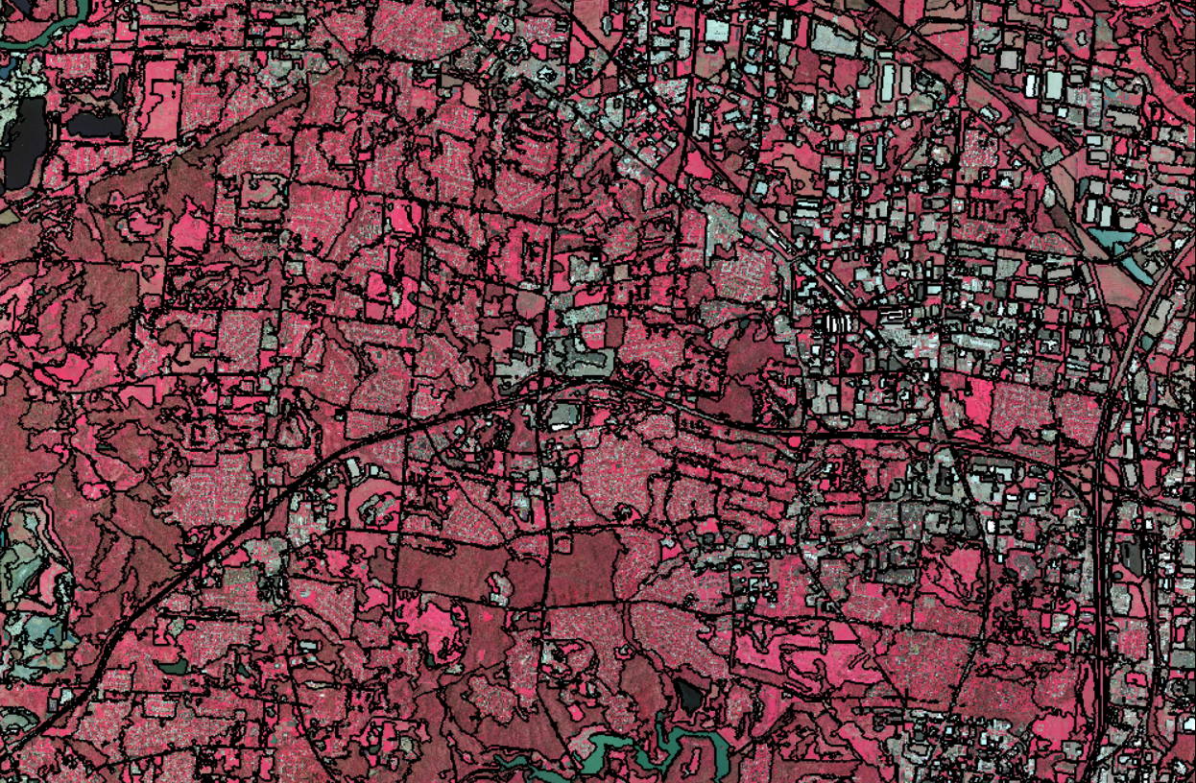
Object scale in training data sets
Applications
Object oriented classification
Object scale 300
Object scale 200
Notes:
On the other hand, remote sensing data can obtain an image,
Meanwhile there is a trade-off between spatial and temporal resolution.
For example, Landsat have 30m spatial resolution but 16 day revisiting cycle,
MODIS have daily frequency. But the spatial resolution is relatively low.

Slide 24
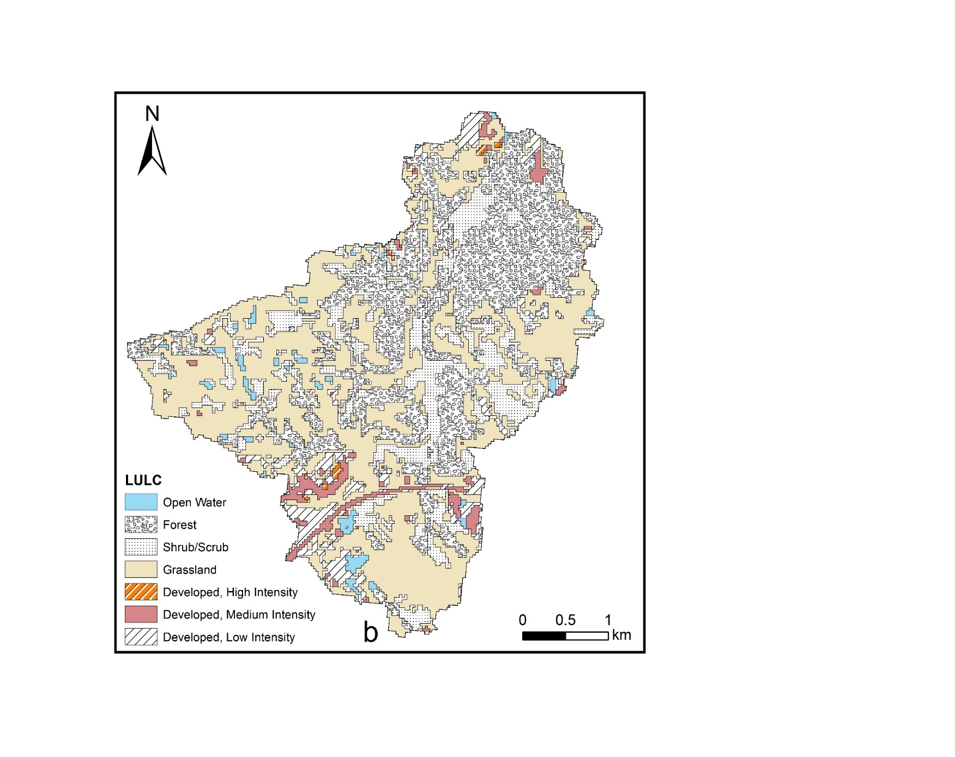
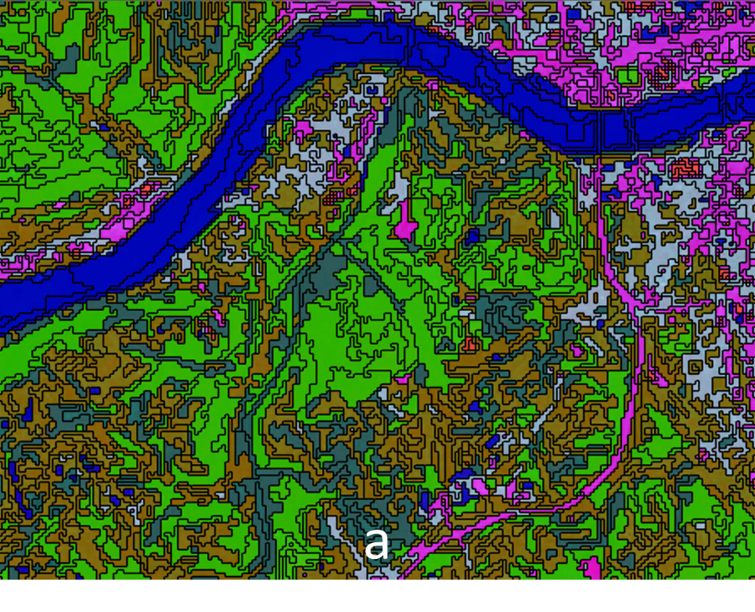
UAV imagery classification
Applications
Object oriented classification
object training samples
Object-oriented classification results
Notes:
On the other hand, remote sensing data can obtain an image,
Meanwhile there is a trade-off between spatial and temporal resolution.
For example, Landsat have 30m spatial resolution but 16 day revisiting cycle,
MODIS have daily frequency. But the spatial resolution is relatively low.

Slide 25
UAV Applications for seagrass
Seagrass standing crop
Mangrove Leaf Area Index (LAI) and canopy closure
Assessing of seagrass abundance

Slide 26
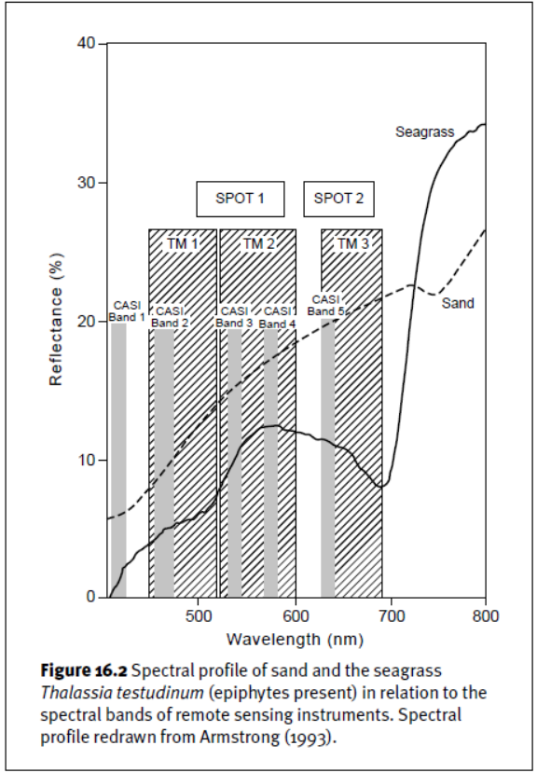
Assessing Seagrass Standing Crop
Bands of 400–650 nm were designated in the region of the electromagnetic spectrum which best penetrates water
The choice of CASI bands is compared to a reflectance profile of the Caribbean seagrass Thalassia testudinum (Armstrong 1993).
Several of the bands have different reflectance characteristics for sand and seagrass which is necessary for discriminating seagrass bottom types using the water column correctionmethod.
Source: Green, E., Mumby, P., Edwards, A., & Clark, C. (2000). Remote Sensing: Handbook for Tropical Coastal Management. United Nations Educational, Scientific and Cultural Organization (UNESCO).

Slide 27
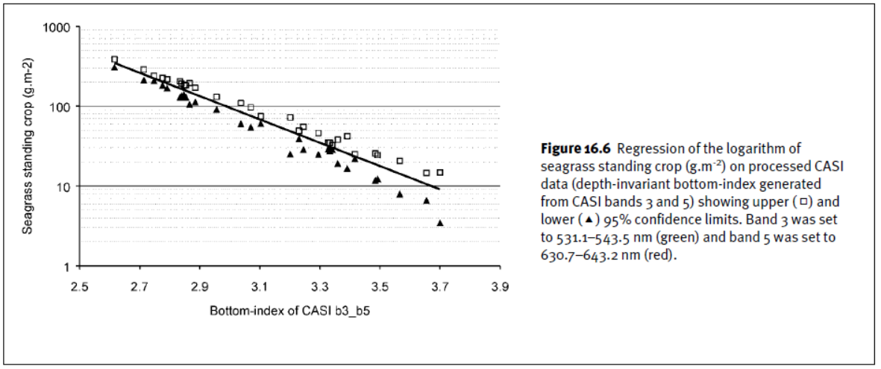
Source: Green, E., Mumby, P., Edwards, A., & Clark, C. (2000). Remote Sensing: Handbook for Tropical Coastal Management. United Nations Educational, Scientific and Cultural Organization (UNESCO).

Slide 28
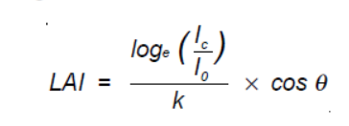
Measurement of canopy transmittance and calculation of LAI
Canopy transmittance is given by the ratio Ic /Io where Ic = light flux density beneath the canopy and Io = light flux density outside the canopy. LAI can then be calculated, and corrected for the angle of the sun from the vertical, using the formula.
LAI = leaf area index, k = canopy light extinction coefficient, which is a function of the angle and spatial arrangement of the leaves.

Slide 29
Assessing of seagrass abundance
Combining the calculation of NDVI, LAI and classification methods.
Change detection,
Two major components:
(1)image optimization and atmospheric correction preprocessing for detailed seagrass classification
(2) a fuzzy synthetic evaluation model for assessing seagrass abundance.

Slide 30
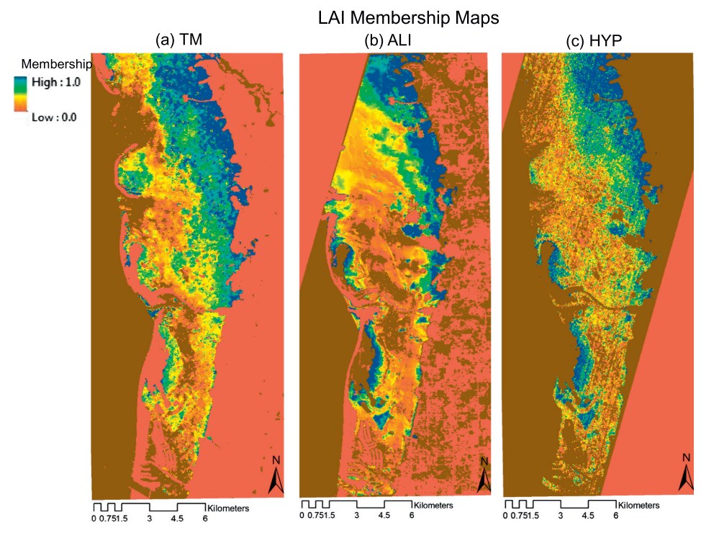
Assessing of seagrass abundance
LAI membership maps created using the three multiple regression models for LAI (Table 5) developed with data from the three sensors [TM (a), ALI (b), and HYP (c)] and field transect survey data
Source: Pu, R.; Bell, S. A protocol for improving mapping and assessing of seagrass abundance along the West Central Coast of Florida using Landsat TM and EO-1 ALI/Hyperion images. ISPRS J. Photogramm. Remote Sens. 2013, 83, 116–129.

Slide 31
GIS data sharing platform
Applications
Open reef data sharing on ArcGIS online
http://ucfonline.maps.arcgis.com/home/item.html?id=a93efd6937a843e4b0fe513696c164f7
Notes:
On the other hand, remote sensing data can obtain an image,
Meanwhile there is a trade-off between spatial and temporal resolution.
For example, Landsat have 30m spatial resolution but 16 day revisiting cycle,
MODIS have daily frequency. But the spatial resolution is relatively low.

Slide 32
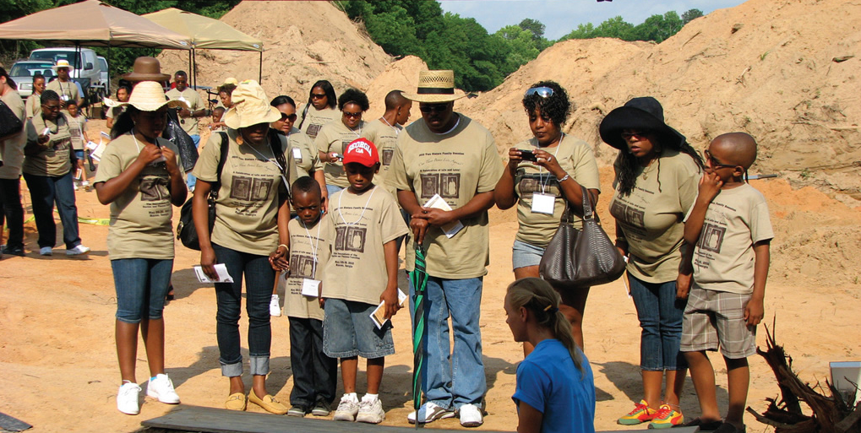


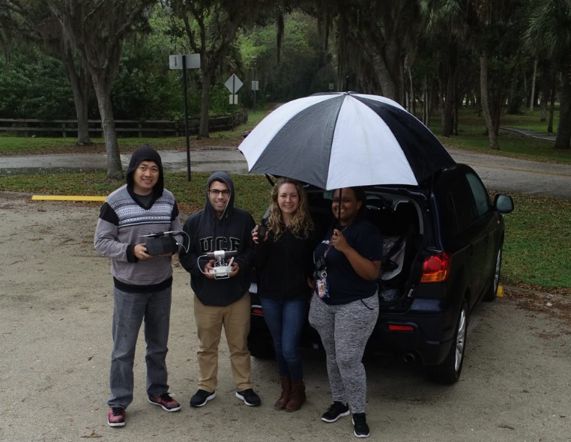
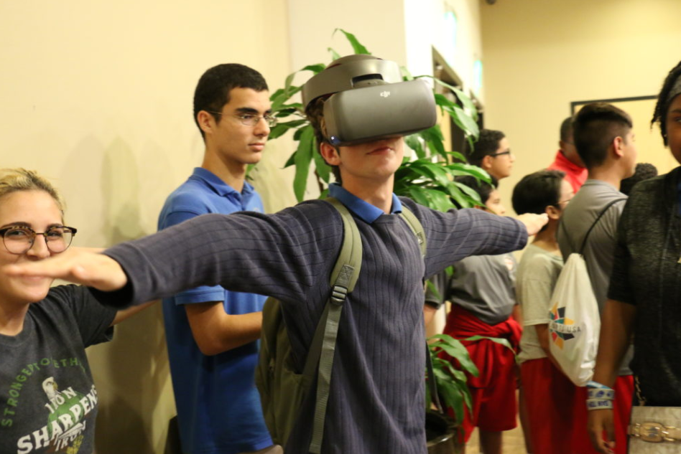
Outreach and community drone projects

Slide 33
Thanks for your attention!
Notes:
Sub AddProgressBar()
On Error Resume Next
With ActivePresentation
For X = 1 To .Slides.Count
.Slides(X).Shapes("PB").Delete
Set s = .Slides(X).Shapes.AddShape(msoShapeRectangle, _
45, .PageSetup.SlideHeight - 57, _
X * .PageSetup.SlideWidth / .Slides.Count - 17, 3)
s.Fill.ForeColor.RGB = RGB(78, 103, 200)
s.Name = "PB"
Next X:
End With
End Sub

